Slide 1

Excerpt 1：
Preparation for writing
group 7
Group members： Chen Yinju（Oral）
Song Yifei （Oral）
Chen Zhilin（Oral）
Ma Rong （PPT&Content）
Chen Genwen（PPT&Content）
Zhou Huibin （PPT&Content）
Date:24.10.17

Slide 2

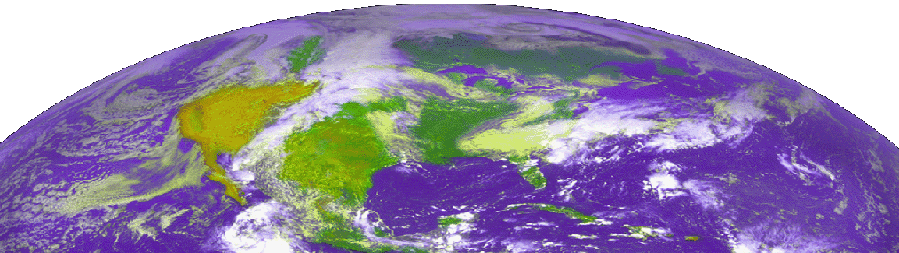
Part 1 Reading &
Part 2 Managing Your Writing Behavior

Slide 3
Content
1
Introduction
2
Reading
3
Self-awareness
4
Conclusion
Notes:
I will introduce introduction.

Slide 4


Introduction
Background
HOW?
As beginner writers, we need
improve our writing skills.
Notes:
As beginner writers, we need improve our writing skills, but how do we do to improve our writing skills?

Slide 5
Content
1
Introduction
2
Reading
3
Self-awareness
4
Conclusion
Notes:
In the next, I will introduce the reading.

Slide 6


Reading
Connection between writing and reading
Have readers constantly
in mind
Think about reading
as writing
Notes:
Firstly, we need find the connection between writing and reading for writers. Actually, writers should have readers constantly in mind and also think about reading as they write.

Slide 7
Reading
Read with an eye to writing
Analyze effective
Ineffective writing elements
React to what others have written
Take hints from anything and everything
Notes:
Secondly, writers should read with an eye to writing: Analyze effective and ineffective writing elements, react to what others have written, take hints from anything and everything.

Slide 8
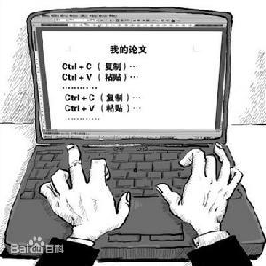

Reading
Avoid plagiarism
Understand the difference between content and style
Paraphrase effectively
Identify sources accurately
Notes:
Finally, writers should avoid plagiarism. Writers need to understand the difference between content and style, paraphrase effectively, and identify sources accurately.

Slide 9
Content
1
Introduction
2
Reading
3
Self-awareness
4
Conclusion
Notes:
Then, I will introduce the self-awareness.

Slide 10
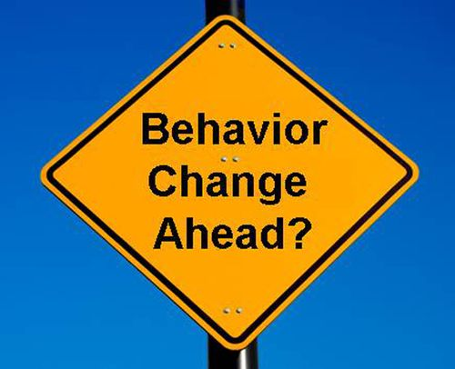
Self-awareness
Importance of self-awareness
Promote you to start positive
behavioral changes
Promote you to maintain positive behavioral changes
Notes:
Self-awareness is very important because self-awareness promotes you to start and maintain positive behavioral changes.

Slide 11


Self-awareness
Tricks for self-awareness
Use reminders
Write logs
Cooperate with a friend
Notes:
To achieve self-awareness, we can use reminders, write logs, and cooperate with a friend to help bring your own behavior periodically to mind.

Slide 12
Self-awareness
Common behavioral challenges
Avoidance
Perfectionism
Distraction
Fear of criticism
Writer’s block
Reluctance to revise
Notes:
Behavioral challenges for writers will probably start with avoidance, distraction, writer’s block, perfectionism, fear of criticism, and reluctance to revise.

Slide 13
Content
1
Introduction
2
Reading
3
Self-awareness
4
Conclusion
Notes:
Finally, I make a conclusion.

Slide 14

Conclusion
Reading
Connection between writing and reading;
Reading with an eye to writing;
Avoiding plagiarism.
Self-awareness
Importance of self-awareness;
Tricks for self-awareness;
Common behavioral challenges.
Notes:
Firstly, it highlights the relationship between writing and reading in science, stresses reading with an eye to writing, and advises on avoiding plagiarism. Then it emphasizes the importance of self-awareness, gives some tricks for self-awareness, and points several common behavioral challenges.

Slide 15
Part 3 Getting Started

Slide 16
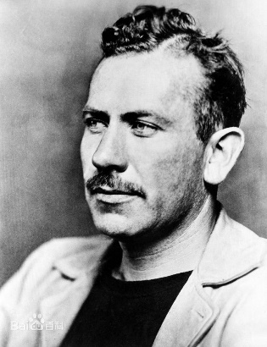
Getting Started
“I suffer . . . from the fear of putting down the first line. It is amazing the terrors, the magics, the prayers, the straightening shyness that assails one” and if he had trouble starting, it can’t be surprising if you or I do (Steinbeck 1969; 13 Feb. 1951, 9).
End up in same place—not having started
Unintentional Non-starting
Intentional Non-starting
Distinguish them by distinct behavior

Slide 17
Getting Started
Unintentional Non-starting
Temporal motivation theory
A form of procrastination
A ∝ ( E * V ) / ( Γ * D )
A (Attractiveness)
E (Expectancy)
V (Value)
Γ (Discounting)
D (Delay)
Temporal motivation theory models task choice as the outcome of a calculation of the attractiveness of each task, with the most attractive being chosen.
Four major factors: Expectancy, Value, Discounting and Delay.
Artificially control the changes.

Slide 18
Getting Started
Unintentional Non-starting
Temporal motivation theory
A ∝ ( E * V ) / ( Γ * D )
A (Attractiveness)
E (Expectancy)
V (Value)
Γ (Discounting)
D (Delay)
Strategies
Simplify the task.
Focus on improving your writing skills
Give yourself confidence

Slide 19
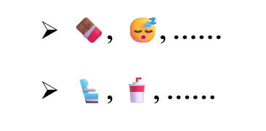
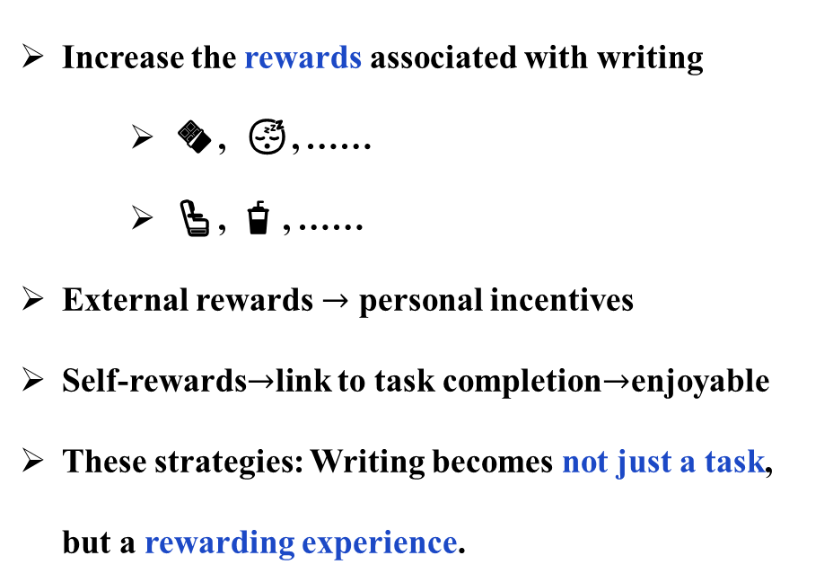
Getting Started
Strategies
Unintentional Non-starting
Temporal motivation theory
Increase the rewards associated with writing
🍫 , 😴, ……
💺 , 🥤, ……
External rewards $→$ personal incentives
Self-rewards$→$link to task completion$→$enjoyable
These strategies: Writing becomes not just a task, but a rewarding experience.
A ∝ ( E * V ) / ( Γ * D )
A (Attractiveness)
E (Expectancy)
V (Value)
Γ (Discounting)
D (Delay)

Slide 20
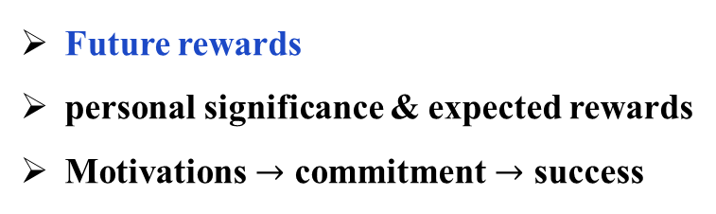
Getting Started
Unintentional Non-starting
Temporal motivation theory
A ∝ ( E * V ) / ( Γ * D )
A (Attractiveness)
E (Expectancy)
V (Value)
Γ (Discounting)
D (Delay)
Strategies
Future rewards
personal significance & expected rewards
Motivations $→$ commitment $→$ success

Slide 21
Getting Started
Unintentional Non-starting
Temporal motivation theory
Strategies
A ∝ ( E * V ) / ( Γ * D )
A (Attractiveness)
E (Expectancy)
V (Value)
Γ (Discounting)
D (Delay)
Reduce procrastination
Timing your self-rewards
Offering small rewards for incremental progress—rather than a big reward for completing the entire task

Slide 22


Getting Started
Intentional Non-starting
Faster and better at the right moment
Wrong
Question: What they’re waiting for?
I don’t have all the data or analyses yet.
I don’t know what I’m going to say yet.

Slide 23
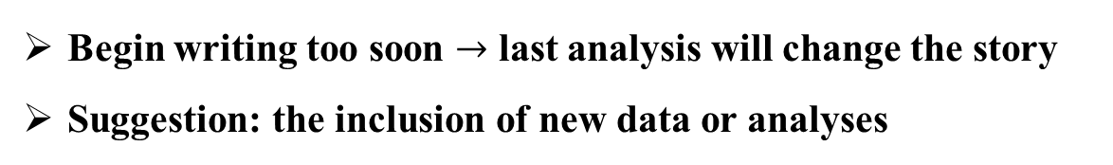
Getting Started
Intentional Non-starting
I don’t have all the data or analyses yet.
Begin writing too soon $→$ last analysis will change the story
Suggestion: the inclusion of new data or analyses
misplaced

Slide 24
Getting Started
Intentional Non-starting
I don’t have all the data or analyses yet.
Begin writing too soon $→$ last analysis will change the story
Suggestion: the inclusion of new data or analyses
misplaced
I don’t know what I’m going to say yet.
Have a static view of writing.
Wait to write until their ideas are perfectly clear.
Most writers write in a dynamic process.

Slide 25
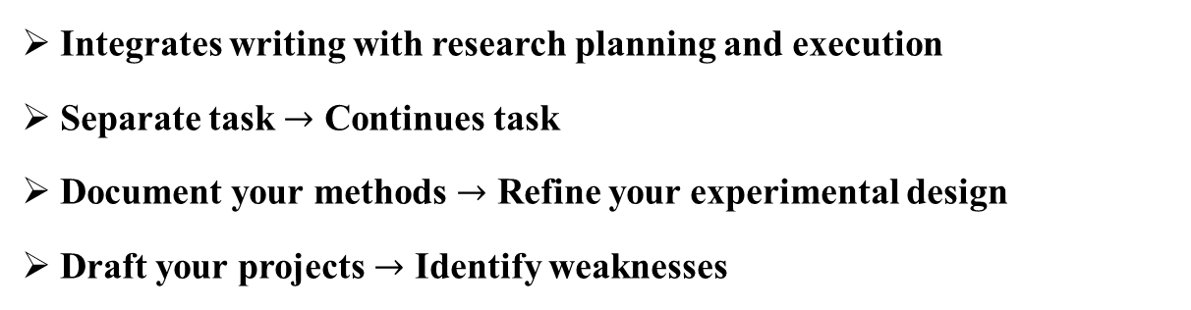
Getting Started
Early Writing
Integrates writing with research planning and execution
Separate task $→$ Continues task
Document your methods $→$ Refine your experimental design
Draft your projects $→$ Identify weaknesses
Simplified, strong, more coherent

Slide 26
Getting Started
Easing In writing process
Begin with the easiest part
writing acknowledgments
drafting figures or tables
outlining your paper
Increase motivation

Slide 27
Part 4 Momentum

Slide 28
The importance of writing momentum
Writing momentum is the key to staying productive
Maintain the pace of writing
The challenges of time management
Important when teaching and researching
Other works distraction
Balance
Find a suitable way
The essence of academic writing
papers, proposals, and technical reports require time and energy
Notes:
In this part, I want to share the importance of writing momentum and its significance in our careers. Writing momentum is the key to staying productive in scientific work. Maintaining writing progress is important when we are teaching and researching. While the time management is challenging, since all of these works can distract us from writing. So, effective time management becomes the foundation for successful scientific writing. In academia, the demands for writing often exceed expectations, with papers, proposals, and technical reports requiring a lot of time and energy. Therefore, finding a balance and creating a Suitable way to writing is essential for achieving long-term success in academic endeavors.

Slide 29
Challenges of starting and continuing
1
Difficulty in starting
psychological barriers to start become obstacle
2
Challenges of continuing to write
Distracted easily when didn’t write for a while
3
Enhance momentum
Startup techniques help break through stagnation Time arrangement help sustaining writing
Notes:
Many writers find it difficult to start new projects; once they started, it will goes well and smoothly . However, the psychological barriers to start often become obstacles. Maintaining momentum is a continual challenge for some, who may be easily distracted, especially after a long period of not writing. Flexibly employing existing startup techniques can help overcome difficulties in sustaining writing, and planning reasonable time blocks for writing can assist in breaking through stagnation.

Slide 30
Discipline
Writers need discipline to write consistently and effectively
Useful techniques:
Writing quotas
Scheduling
Timing
01
Daily output (words)
Encourage getting started
or input (hours)
More flexible to various tasks
02
Create a fixed schedule
Prevent other tasks get in the way of writing
Form habit and reduce distractions
03
Write in the morning
Willpower depletes over time
Environment
More exotic commitment devices
04
05
Notes:
Scientific writers need discipline to write consistently and effectively. Here are some useful techniques to maintain this discipline:
Writing Quotas: Set daily writing quotas based on either output (such as words written or revised) or input (hours spent writing). Output quotas help overcome the challenge of getting started, as they encourage producing any writing at all, which can later be revised. Input quotas are more flexible and adaptable to various writing tasks but may be less effective if the time spent isn’t productive.
Scheduling: Create a fixed writing schedule to prevent other tasks from encroaching on writing time. Scheduling establishes a routine, eliminating the need to make moment-to-moment choices about whether to write. Sticking to a specific time each day can reinforce the habit and reduce distractions.
Timing: Consider writing early in the day with a fresh willpower. Studies suggest that willpower depletes over time, so we should write early in a day before the willpower gets down.

Slide 31
Discipline
Writers need discipline to write consistently and effectively
Useful techniques:
Writing quotas
Scheduling
Timing
01
02
03
Environment
More exotic commitment devices
04
Remove distractions
Clean and no distractions helps concentrate and productive
05
Public or peer-based group
Help develop discipline, write effectively and consistently
Notes:
Environment: Optimize your writing environment by eliminating distractions. Keep your workspace clean and remove items like smartphones, games, or other visual distractions that could interrupt your focus. Creating a distraction-free environment enhances concentration and boosts productivity.
More exotic commitment devices: Use commitment devices to hold yourself accountable, such as making a public writing commitment or joining a writing group. You could attend “Shut Up and Write” meetups or participate in virtual writing sessions with colleagues. Public accountability or peer support can add extra motivation to stay on track.By using these strategies, scientific writers can develop discipline, overcome procrastination, and ultimately write more effectively and consistently.

Slide 32
Binge and Snack Writing
Two effective habits of writing
Binge writing : Consists of long, focused sessions
Snack writing : Shorter, more frequent sessions
allow for deep thought and is suitable for complex tasks
can be surprisingly productive, especially when it is done consistently
Each has its advantages and suitable situations
Combining both approaches can be beneficial
Notes:
I’d like to share some insights into effective writing habits for scientific work. Writers often debate between 'binge writing,' which consists of long, focused sessions, and 'snack writing,' which is made up of shorter, more frequent sessions. Each approach has its merits. While longer sessions allow for deep thought and are suited to complex tasks, short sessions can be surprisingly productive, especially when done consistently. Studies suggest that thirty to ninety-minute sessions, if done regularly, can add up to significant progress. However, since not every writer has large blocks of time available, combining both approaches can be beneficial. If you can, use longer sessions for tasks that need detailed attention, like structuring your argument or drafting the introduction. For other tasks, short sessions might do the trick.

Slide 33
Interruptions, Intermissions, and Momentum
Interruptions and intermissions can disrupt momentum
1.Lose focus
2.Have to spend valuable time getting back into the flow
Minimizing unplanned interruptions
Choosing a quiet environment
Turning off your phone
Reducing other distractions
Choosing a quiet environment
To leave a ‘loose thread’ in your work
leave a sentence unfinished instead of finishing a section before stop
unfinished thought helps get back to writing
Notes:
"Interruptions and intermissions between writing sessions can seriously disrupt our momentum. Each time we stop, we not only lose focus but also have to spend valuable time getting back into the flow. A common way to counteract this is by minimizing unplanned interruptions. Choosing a quiet environment, turning off your phone, and reducing distractions can certainly help. But, realistically, life sometimes gets in the way, and we do get interrupted.
In those moments, a useful technique is to leave a 'loose thread' in your work. Instead of finishing a section before stepping away, leave a sentence unfinished or jot down quick notes about what you were planning to write next. This unfinished thought becomes a thread you can pick up when you return, helping you regain your momentum quickly.
This strategy works not only for unplanned interruptions but also for planned breaks. Rather than wrapping things up neatly, try to leave yourself something to come back to. This way, you’ll find it easier to jump back in and keep the writing flowing."

Slide 34
Three kind of writer personality
Different ways writers build momentum
' Swoopers ' :who draft quickly and edit later
Quality of the first draft is not evaluated much
‘ Bashers ' : who perfect each sentence as they go
Have insist on perfect phrase and paragraph
‘Dragger’: who gets stuck aiming for perfection too early
Struggle to write the beginning perfectly
Struggle with dragging: 'storming the beach’
Finish a first draft without worrying about details
Write ideas down and refine later
Notes:
"There are different ways writers build momentum. The first kind is 'swoopers,' who draft quickly and edit later, and 'bashers,' who perfect each sentence as they go. But there’s a third type—the 'dragger'—who gets stuck aiming for perfection too soon.
For those who struggle with dragging, 'storming the beach' might be the answer. It means pushing through a messy first draft without worrying about details. The focus is on getting ideas down and refining later. This method helps you avoid getting stuck and keeps you moving forward. If you’re dragging, try swooping instead—charge ahead, and polish once you’re off the beach."

Slide 35
Coping with writer's block
Effective methods to overcome writer’s block
Write two versions of the passage you’re stuck on
Lower your standards
Divide and conquer
Quality of draft is not that important. Write it and then revise it
01
02
Divide the task into reachable steps
03
Then choose the better version to solve the stuck
04
Change your environment
06
Freewrite
05
Talk it out
Easy to reach
Different sight, sound, touch, and smell
Record and listen
Set a timer and write whatever comes to your mind
Notes:
Writer’s block is not an external obstacle but an internal perception that can be overcome by actively choosing to write despite the challenges. Here are some effective methods to overcome writer’s block:

Slide 36
Coping with writer's block
Effective methods to overcome writer’s block
Skip ahead
Back up
Take a break
Find a straightforward task and come back with a good mood
Back up paragraph and modify it rather than rewrite it
07
08
09
More concentrate with a relax mood
Notes:
Writer’s block is not an external obstacle but an internal perception that can be overcome by actively choosing to write despite the challenges. Here are some effective methods to overcome writer’s block:

Slide 37
THANK YOU FOR WATCHING

